Slide 1
INTEGRATED PROJECT
EXPLORE AI ACADEMY
ZAAKIR LOONAT

Slide 2

Problem Statement
The Insurance Company is struggling with a crucial issue as they strive to effectively monitor and analyze the correlation between insurance claims and collected premiums. The current reporting system lacks the required dashboard reports, hindering the company's ability to derive meaningful insights, make informed decisions, and optimize resource allocation.The absence of real-time monitoring, coupled with limitations in visualizing claims versus premium data and conducting client segmentation and risk analysis, accentuates the challenge. To address this, the company is initiating the development of an interactive Power BI dashboard to actively monitor and analyze insurance claims, collected premiums, and gain valuable insights into client behaviors

Slide 3
Project Landscape
Affordability Analysis Evaluating current insurance premiums and assessing affordability for various demographics.
Insurance Knowledge Gaining access to features considered by individuals currently paying premiums and understanding market premiums.
1
2
3
Target Marketing Insights Investigating the current marketing strategy, target demographics, and external factors affecting marketing beyond unemployment rates and pool availability.
4
Comparative Market Analysis Exploring premium charging strategies in other countries, accessing claim histories in the current market, and understanding industry and international marketing strategies.

Slide 4
DATA
INFORMATION
KNOWLEDGE
Data Source:
Data is supplied by Explore AI and is accessible on a public GitHub repository.
Data Ownership:
Ownership of data lies within insurance companies.
Data Formats:
The data is available in both CSV and XLSX formats, providing flexibility in data utilization.
Data Quality:
A comprehensive review will be conducted to ensure the cleanliness and completeness of the data.
Feature Engineering:
Evaluation of the need for feature engineering to enhance the dataset's relevance and predictive power.
Data Update Frequency:
Regular updates of the data will be tracked to ensure real-time relevance for analysis.
Data Import:
Proficiency in importing data from Excel and CSV formats, ensuring seamless integration into the analysis pipeline.
Data Manipulation:
Utilization of Power Query for data manipulation, ensuring data is structured for meaningful insights.
Dashboard Creation:
Development of interactive Power BI dashboards to visualize and communicate key insights effectively.
Resource Management:
Efficient allocation and management of resources throughout the project to optimize outcomes

Slide 5
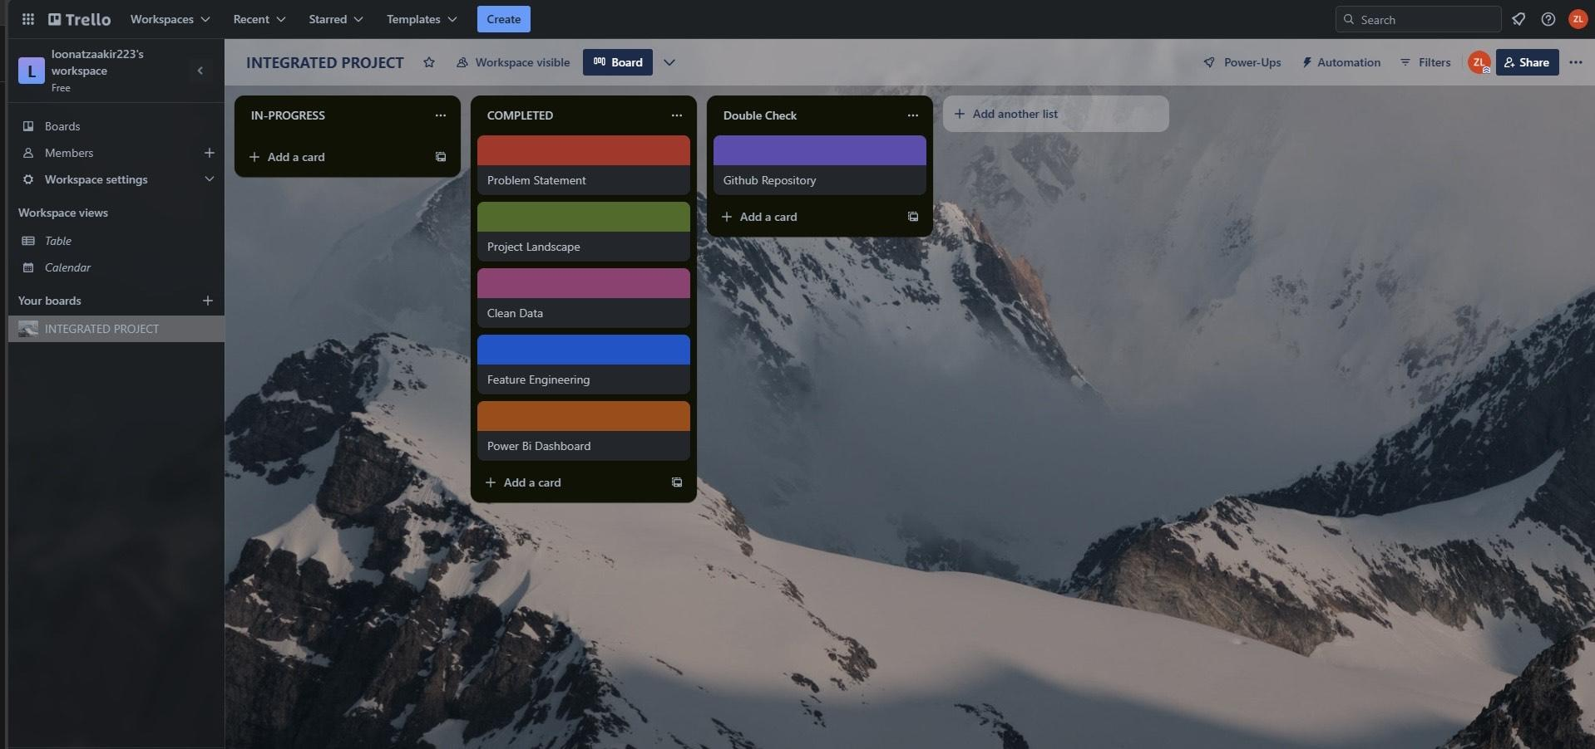
Proposed solution
Trello Board

Slide 6
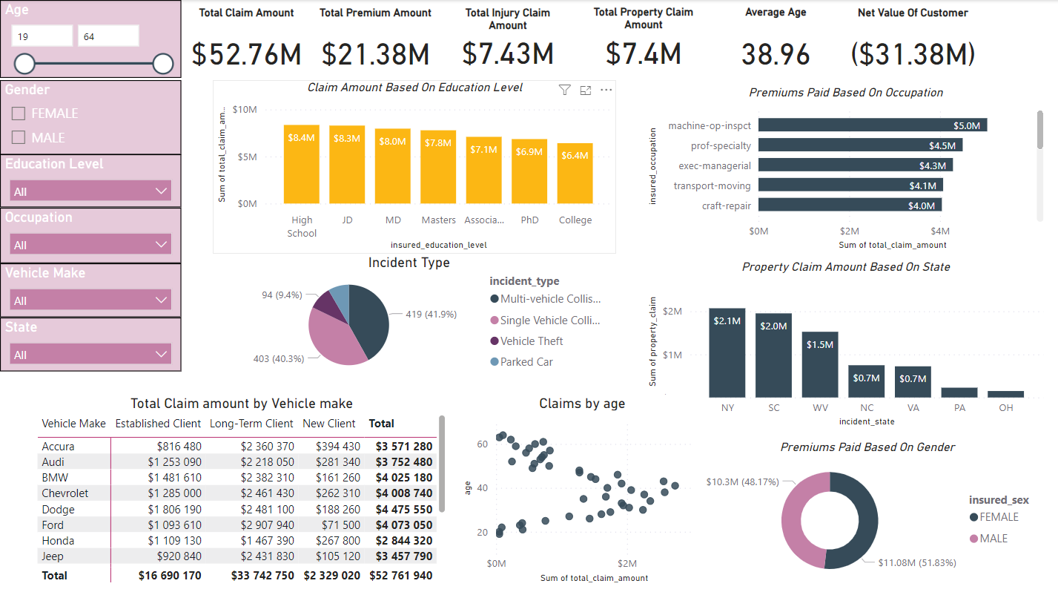
Power Bi Dashboard

Slide 7
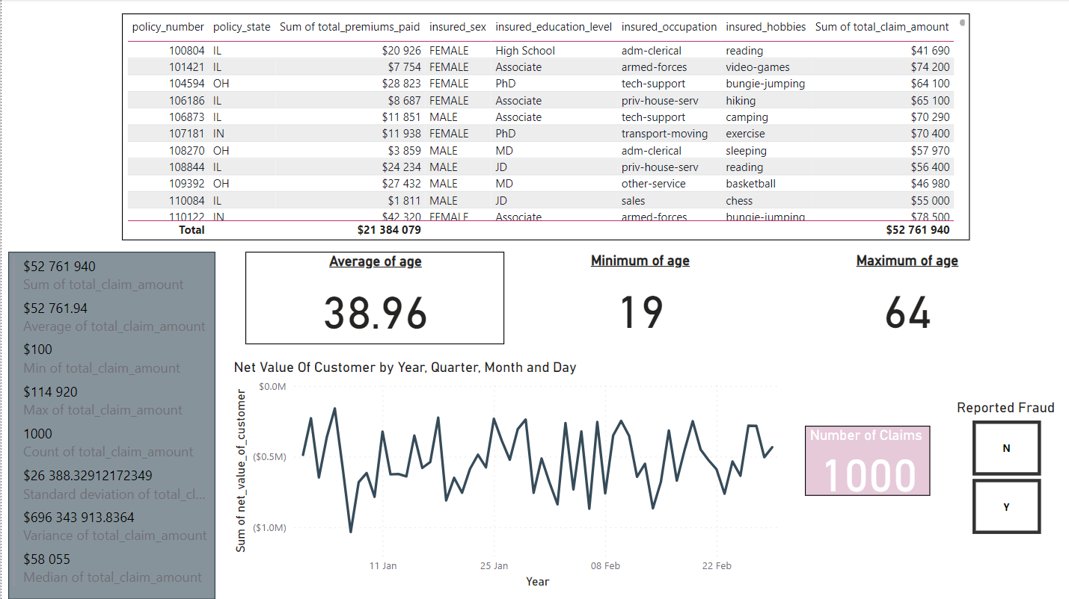

Slide 8
Proposed solution
GitHub Link
https://github.com/Zaakir223/Integrated-Project

Slide 9
Thank you.

